Slide 1
What is Roll-out?
Scout
Empowering Customer Engagement
November 2020

Slide 2
What is Roll-out?
The Scout solution will be delivered to 61 countries by Q4 2021.
This represents a significant logistical challenge.

Slide 3
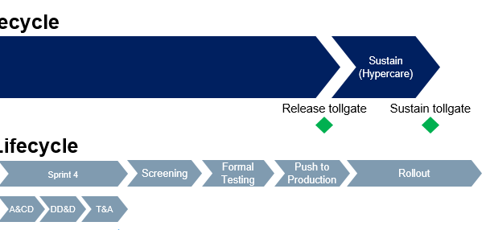
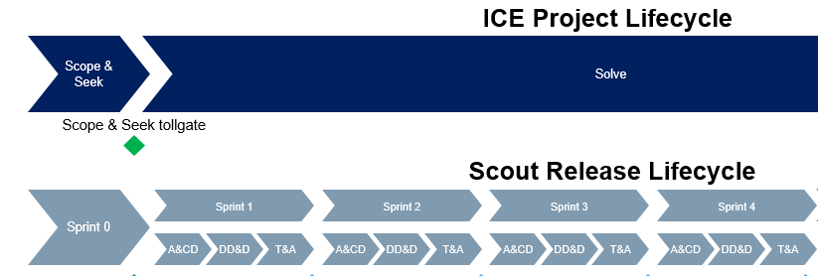
What is Roll-out?
To manage this challenge, we will ‘roll-out’ Scout to groups of countries in six ‘Waves’, three for Region Europe/North America and three for SIR (International Markets)
In addition, countries who have already gone live on Scout have to be managed through future Releases or ‘upgrades’
Waves are off-set from Releases to avoid cutover of multiple NEW countries and multiple LIVE countries at the same time
WAVE
R1
Pre Roll-out
Preparation
Implementation
Roll-out
Operate/Adopt
R1

Slide 4

Scout Program - Deployment Timeline
2020
2021
 |  | Jun | Jul | Aug | Sep | Oct | Nov | Dec | Jan | Feb | Mar | Apr | May | Jun | Jul | Aug | Sep | Oct | Nov | Dec
SFE Pilot OM Pilot CM Pilot
Wave 1
Wave 1A (SIR)
Wave 2 Wave 2A (SIR)
Wave 3 Wave 3A (SIR)
Switzerland Live!
CRM Release 1 (SFE & Marketing)
Switzerland
Order Management Release 1
Switzerland
US Contract Management Live!
United States
Canada, Baltics, Netherlands, UK, South-East
& East Cluster, Central Asia Cluster, SDZ DD
18 countries Live!
Receive CRM
Pilot Functionality
Receive CRM
R1 Functionality
Gulf & Levant, Egypt, Algeria, Thailand, Vietnam, Malaysia, Singapore, Philippines,
Korea, Taiwan, Hong Kong, South Africa
Poland, Nordics, Germany, Hungary, Czech, Slovakia, Russia, Greece, Ukraine
Receive CRM
R1 Functionality
Bangladesh
Iberia, France, Austria, Belgium, Italy, Germany (OM)
CRM Only: US
Receive CRM R1 & OM R1 Functionality
Australia
CRM Only: Japan, Turkey, Pakistan*(*dependent on devices)

Slide 5
Roll-out Summary:
 | Countries | Users (apprx)
Wave 1 +CH+US CM | 20 | 1000
Wave 1A (SIR) | 17 | 750
Wave 2+2A | 13 | 2700
Wave 3+3A | 11 (+DE OM +US CRM) | 1450
 | 61 | 5900

Slide 6
What is Roll-out? High-level Activities
Local Engagement & Buy-In
Data Migration Data from legacy systems, third party providers etc must get into SCOUT.
Some will be integrated directly from IQVIA, XPEND or SAP, but most data including all transactional data (calls etc) will be loaded via pre-defined templates created by the program DM team. For SPACE/ONCORE countries the Roll-out Team will extract and transform this data into the DM templates, consulting with the countries as needed. For non-SPACE legacy, more country input will be needed.
Country Specific Settings Capture
Even with a global design, certain design features will require input on settings and parameters each time a new country goes live.
For each release the Design Team will need to share a list of the parameters needed, so these can be captured by the Roll-out team on a country by country basis in a structured workbook. The Axtria Sales Planning templates for example require a significant amount of time and local expertise to complete.
Change Communications & Training
Translations 13 languages have been defined as in scope for Scout SYSTEM translations. The Roll-out Team will work with the Sandoz-appointed translation agency to ensure all Salesforce and Apttus labels etc are translated ,but countries will need to provide their own translations of some Pitcher and Axtria labels, and will also need to localise email templates etc
Testing/Validation
All countries will need to ‘sense check’ their data migration, set-up and translations in Scout
Local involvement in testing/validation has several purposes: meeting compliance standards, quality assurance and business engagement.
Local Roll-out Testing is a formal test phase executed in PROTON

Slide 7

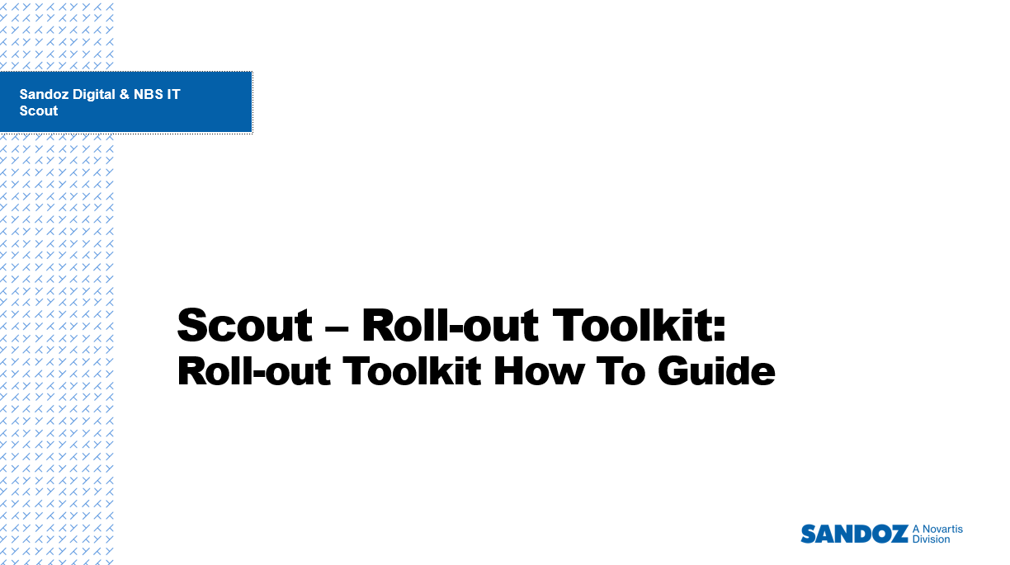
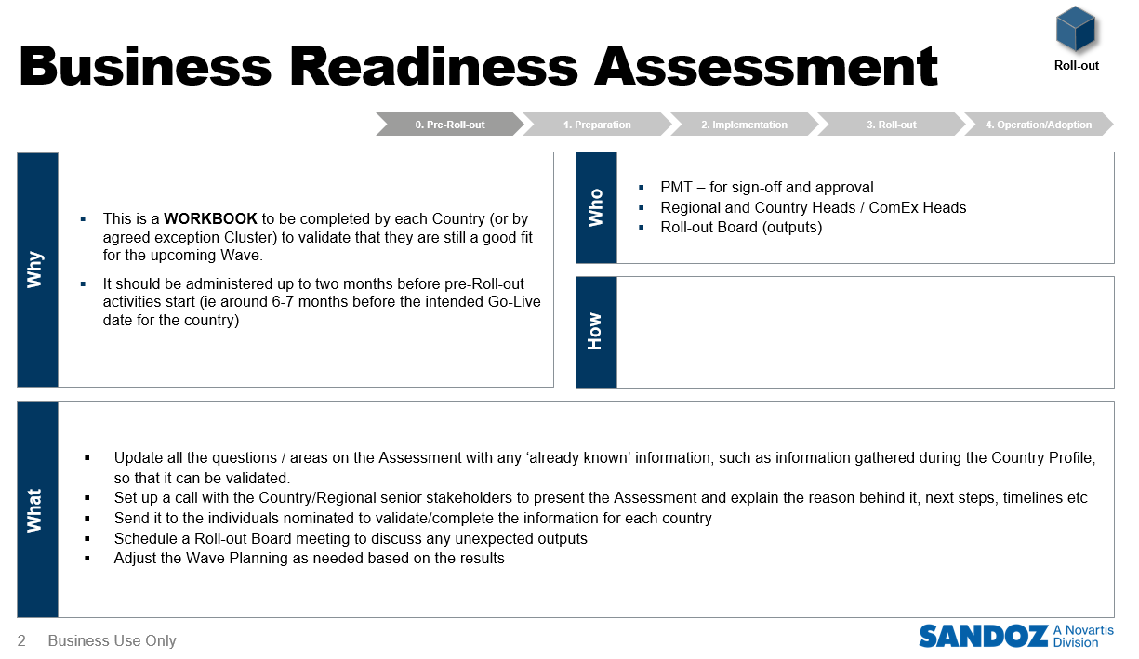
What is Roll-out? Toolkit Approach
To facilitate delivery of many countries in a single Wave, a ‘tried and tested’ standardized approach is needed
Throughout the pilot and then future sprints for each Release, the Roll-out team work with the Business Champions & SMEs to develop a series of templates, workbooks and checklists that will support the onboarding of new countries to Scout in a Wave
This approach drives consistency and saves time
All the templates, workbooks and reference materials needed to successfully deliver the solution in each country. Located within Teams, our program collaboration tool

Slide 8
Roll-out Toolkit Highlights
Business Readiness Assessment
Local Leadership Engagement Meeting
Country
Kick-off
Resource Requirements Template
Localised Checklist
and Plan
Data Migration Workbook
Country Set-up Workbook
Local
Testing
Scope & Plan
Cutover
Plan
Template
Hypercare Operation Template
LocalisedSupport Model
Translation Workbook
0. Pre-Roll-out
1. Preparation
2. Implementation
Country Weekly Status Meetings
3. Roll-out
4. Operation/Adoption
Weekly, between Local Roll-out Manager of each Country/Group and the Program Roll-out Coordinator
Country/Sub-Cluster Steering Committees
Every 2-4 weeks depending on Roll-out Phase, with Country/Sub-Cluster senior stakeholders, to report progress, make decisions, and resolve issues
Roll-out Checkpoints
Five Checkpoints across the Wave phases that ensure all Regional, Country and Cluster stakeholders are aligned on Wave progress and status
Show & Tells
Joint activities with CC&T to ensure the Countries are aware of the

Slide 9
Release Teams and Roll-out
RELEASE TEAMS:
Gather, analyse, understand and prioritise the business requirements from the countries, clusters and regions, all within the context of the Scout Program Objectives
Determine the scope of the integrations to/from Scout, and the data migration scope.
Organise this ‘scope’ into ‘Releases’
Design, Build and Test the Functionality for each Release
Deliver this Functionality onto the Scout platform
Support the PILOT countries by including their data and set-up in the Pilot Releases
Ensure appropriate templates and guidelines are knowledge-transferred to Roll-out so a toolkit and template approach can be employed to onboard future countries to Scout
Roll-out Team:
Receive knowledge-transfer from the Release Teams in the form of templates and handover sessions
Enhance the templates as needed and provide ‘how to guides’ to capture country-specific information (data, translations, content, set-up parameters) needed to onboard new countries to the global design.
Support the countries in each Wave with planning, governance, template completion, understanding the global design etc
Manage knowledge transfer of the Roll-out Toolkit to the Regional Support teams so they can support live countries and future onboardings
Manage the Cutover/Hypercare process for Waves

Slide 10
Country Set-up vs New Requirements
Wave Go-Live on Release R
Early engagement / Walkthroughs (tbc)
Pre Roll-out
Preparation
R
Implementation
Roll-out
Operate/Adopt
Roll-out Team works with countries to capture their ‘Country Set-up’: localizations of existing released functionality:
Translations of labels etc
Content files for Detailing
Local versions of global email templates (language, address etc)
Country Territory Hierarchy…etc
If during the Roll-out process new REQUIREMENTS are identified, these will be brought to the Lead Product Owners for triage, and a Governance Process will need to be implemented to determine how they are managed
Example: Name of Approver in an existing Approval Process: Country Set-up. Adding another level/threshold of an Approval Process: New Requirement
Design Team ensure that the Wave countries legal, regulatory and market requirements are covered in the Global design
R
RELEASE R
RELEASE R+1
Design of Release R
(Business Champions / SMEs)

Slide 11
Roll-out Dependencies
Timelines, resource dependencies & availability, scope of R1
Release Planning
(CRM, OM, CLM)
Provide DM Scope, Templates, Mappings, How-to Guides, KT,
Input to Country Set-up Workbook including Translations
Data Migration
Design
(CRM, OM, CLM)
Scout
Roll-out
Input to Country Set-up Workbook
WAVE SET-UP
Integration
Pitcher
Axtria
Input to Country Set-up Workbook including Translations
WAVE SET-UP
Translation Workbench Exports
Support with creating Wave IQ document
Application Build
Release Management
Support with creating Wave IQ document

Slide 12

Who are the Roll-out Team?
Regional CRM/Scout Lead
(Chiara Ippoliti /
Ludmilla Reina)
Program Roll-out Lead
(Helen Lewis)
Program CC&T Lead
(Anja Wittig)
Program Roll-out
Coordinators
Program Roll-out
Local Testing Lead
Program Roll-out
Local Cutover / Hypercare Lead
Program Roll-out
Data Analysts
Program CC&T Roll-out & Release Coaches x(?)
Group 1
Group 2
Group 3
Group N
Regional ComEx
Scout Resource Pool
Local Roll-out Manager
Local Roll-out Manager
Local Roll-out Manager
Local Roll-out Manager
Country 1
Country 1
Country 1
Country 1
Country 2
Country 2
Country 2
Country 2
Country N
Country N
Country N
Country N

Slide 13
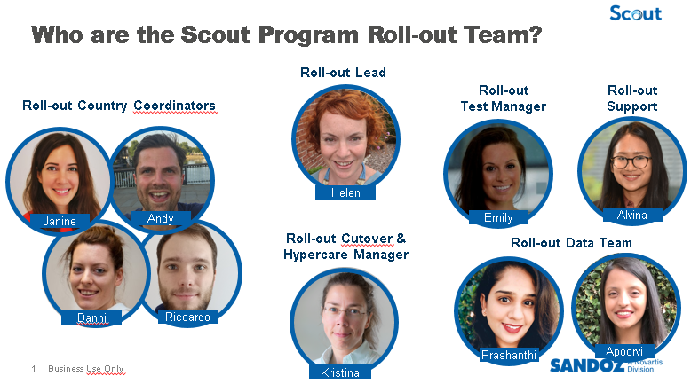

Slide 14
Roll-out: High-Level Plan – Wave 1A
Latest Update: 13th November, 2020
0. Pre-Roll-out
1. Preparation
2. Implementation
3. Roll-out
4. Operation /
Adoption
NOVEMBER
DECEMBER
JANUARY
FEBRUARY
MARCH
APRIL
MAY
09 | 16 | 23 | 30 | 7 | 14 | 21 | 28 | 04 | 11 | 18 | 25 | 01 | 08 | 15 | 22 | 01 | 08 | 15 | 22 | 29 | 05 | 12 | 19 | 26 | 03 | 10 | 17 | 24
Governance: Steering Committees
Checkpoints 1-5
Change & Comms
Train-the-Trainer / End User Training
Data Activities
Country Setup
Translations
Local Testing
Cutover Activities
Go-live / Hypercare
Release Activities
Program Governance
Roll-out Workshop
Checkpoint 1: Roll-out Charter
Checkpoint 3: Entry to Testing
Checkpoint 4
Go-live Readiness
Checkpoint 5
Hypercare Exit
Checkpoint 2: Roll-out Preparation
Stakeholder analysis, comms set-up
Change Impact Analysis
CC&T Kick-off
Go-live Count-down
Solution Adoption
Training Needs Analysis
Train the Trainer
End-User-Training
Local Test Planning
Roll-out Local Test
QA Cutover
Production Cutover
Hypercare
Key:
High-level activity
: Milestone
: Other Team Dependent Activity
: Steering Committee

Slide 15
Roll-out: High-Level Plan – Wave 2 / 2A
Latest Update: 13th ^{h} November, 2020
0. Pre-Roll-out
1. Preparation
2. Implementation
3. Roll-out
4. Operation /
Adoption
NOVEMBER
DECEMBER
JANUARY
FEBRUARY
MARCH
APRIL
MAY
JUNE
16 | 23 | 30 | 7 | 14 | 21 | 28 | 04 | 11 | 18 | 25 | 01 | 08 | 15 | 22 | 01 | 08 | 15 | 22 | 29 | 05 | 12 | 19 | 26 | 03 | 10 | 17 | 24 | 31 | 07 | 14 | 21
Governance: Steering Committees
Checkpoints 1-5
Change & Comms
Train-the-Trainer / End User Training
Data Activities
Country Setup
Translations
Local Testing
Cutover Activities
Go-live / Hypercare
Release Activities
Program Governance
Roll-out Workshop
Checkpoint 1:
Roll-out Charter
Checkpoint 2:
Roll-out Preparation
Checkpoint 3: Entry to Testing
Checkpoint 4
Go-live Readiness
Checkpoint 5
Hypercare Exit
CC&T Kick-off
Stakeholder analysis, comms set-up
Change Impact Analysis
Go-live Readiness
Solution Adoption
Training Needs Analysis
Train the Trainer
End-User-Training
Local Test Planning
Roll-out Local Test
QA Cutover
Production Cutover
Hypercare
Key:
High-level activity
: Milestone
: Other Team Dependent Activity
: Steering Committee

Slide 16
Roll-out Waves 1A, 2, 2A, 3, 3A: Key Dates
 |  | Wave 1A | Wave 2/2A | Wave 3/3A
Checkpoint 1 | Roll-out Charter | By 4 Dec | By 11 Dec
Checkpoint 2 | Roll-out Preparation | By 18 Dec | By 15 Jan
Checkpoint 3 | Entry to Testing | By 24 Feb | By 2 April
Checkpoint 4 | Go-live Readiness | By 16 April | By 19 May
Checkpoint 5 | Exit from Hypercare | By 21 May | By 25 Jun

Slide 17
How can I find out more?
General Information:
We are currently building out the Roll-out pages on Scout Navigator, the Scout Intranet. Please check back from time to time for updates
Email us on: scout.rollout@novartis.com
Roll-out Useful Reference Information:
Will be provided to you by your Roll-out Coordinator
Will be shared in the Teams Wave 1A Document Library
If you need a specific document, please ask!
Roll-out Toolkit:
Currently being enhanced based on Wave 1 lessons learned – will be shared by your Coordinator
If you have a question about a specific Toolkit item, please ask!
Talk to us and ask us questions!

Slide 19
Appendices
Sandoz Digital & NBS IT
Scout
Notes:
Key visual to be updated

Slide 20
Roll-out: PROGRAM Team Members
Role | Main responsibilities | Main Activities
Program Roll-out Lead | Accountable – together with Regional ComEx colleagues - for all Roll-out delivery. Manage Program Roll-out Team Manage relationship with Sandoz Regions and Countries via ComEx colleagues Manage relationships and interactions with all other Scout Workstreams Roll-out Status tracking Roll-out Risk and issue management | Program level meetings and status updates Daily team status updates to ensure all countries in a wave are on track Status tracking Risk and issue management Wave/Group/Country Steer-Cos and Checkpoint meetings
Program Roll-out Co-ordinators | Manage one or more Groups of Countries in each Wave of new Countries, from the Pre-Roll-out Activities through to end of Hypercare Coordinate the Roll-out activities of each Country through the Cluster and Local Roll-out Manager/s Act as escalation point to the Program for the Local Roll-out Managers Accountable for Checkpoint Sign-offs of all managed Countries | Business Readiness/Early Engagement Regular status updates with all Countries Steer-Cos and Checkpoint meetings Daily team status updates to ensure all countries in a wave are on track
Program Roll-out Local Testing Lead | Own the Local Test Strategy/Protocol and ensure it remains aligned with dependent documents like the Program Test Strategy and the Data Migration Test Strategy Accountable for Local Test activities (Scope, Planning, Training, Execution), managed through the Program Roll-out Coordinators Responsible for engaging with Program PQ stream to ensure country resources are engaged where appropriate | PROTON Training for all Test Script writing & maintenance (data, translations, local set-up) Test Script selection & management (functional process scripts from PQ to be reused) Coordinate set-up of users in all test systems Daily team status updates
Program Roll-out Local Cutover/Hypercare Lead | Own the Cutover Plan for a Wave Accountable for Local Cutover activities (Planning, Execution), managed through the Program Roll-out Coordinators Responsible for engaging with the other Work Streams (Data Migration, Integration and P2P team) to ensure all technical aspects of the Cutover are in line with the Local plan and expectations Responsible for engaging with Program Release Cutover Lead to ensure live country resources are engaged where appropriate for a new ReleaseOwn the Hypercare Plan for a Wave Responsible for engaging with the other Work Streams to appropriate involvement, resourcing and planning. | Planning Alignments with all other Workstreams Alignments with Countries via Program Roll-out Coordinators Daily team status updates Manage Cutover execution for each Wave Support Cutover execution for each Release Set-up and manage triage calls during Hypercare Produce daily reports Prepare Checkpoint 5
Program Roll-out Data Support Analyst | Align with the Data Migration Team to understand the Scout Data Migration Templates and Mapping Files Work as directed by the Roll-out Lead and Roll-out Coordinators to support the countries in a Wave in getting their data mapped and transformed into the Scout data migration templates Provide feedback to country and Roll-out Coordinator on the data quality and cleaning required based on initial data migration loads | Mapping and transforming legacy data from raw extracts to Scout template format Liaising with country data experts to ensure mapping is correct and data cleaning takes place Providing the completed data templates in a timely mannger

Slide 21
Roll-out: Region/Cluster/Country
Role | Main responsibilities | Skills & competencies | Recommended Resource | Main Activities
Country Head | Overall accountable for local implementation and user adoption after go-live Allocation of local resources | Leadership Stakeholder management | Existing Sandoz Role | Steering Committee Meetings Local change events
Regional/Cluster Roll-out Manager | Supports Program Roll-out Coordinators with access to local country resources and Cluster/Regional escalations/governance Ensuring familiarity with all Roll-out Toolkit templates and workbooks to provide back-up to Program & Local Team members | Project management Change management | Regional appointment | Back-up for Program Roll-out Coordinators and Local Roll-out Coordinators Facilitates governane process (sets up Checkpoint reviews at Cluster and Regional level)
Local Roll-out Manager | Owns local plan, checklist and logistics. Responsible for ensuring that the project impact is well understood in the country. Owns country Roll-out governance, schedules and runs country SteerCos. | Project management Change management | Local CRM Manager? Local ComEx? Local IT? | Planning & Communications Status Updates and SteerCos Coordinates local activities & resources Managing Local Testing, Cutover & Hypercare
Functional Experts | Completing the Country Specific Settings Workbook Completing the Axtria Sales Cycle Planning set-up templates | Deep understanding of local business processes | Territory Heads? Sales Leaders / influencers? CRM Managers? | Executing/Supporting Local Testing Supporting End User Training Support Hypercare
Data Experts | Validates data mappings with the Data Migration Team Completes the Data Migration Templates for Base/Master and/or Transactional Data (with support from Program where necessary) | Good knowledge of business processes in country Deep understanding of local data | CRM Manager? Local IT? | Support Data Mapping Validation Support Data Template Filling Executing/Supporting Local Testing Supporting Cutover & Hypercare

Slide 22
Roll-out: LOCAL Team Members
Role | Main responsibilities | Skills & competencies | Recommended Resource | Main Activities
Functional Testers | Receive Proton training Receive basic Scout navigation training Execute Test Scripts | Knowledge of business processes | Business Users | Execute Test Scripts Raise defects Re-test fixes
Data Testers | Receive Proton training Receive basic Scout navigation training Execute Test Scripts | Testing | Business Users | Execute Test Scripts Raise defects Re-test fixes
Translation Testers | Validating the translations provided in the system | Native Speaker of target language Sufficient English to provide feedback | Any local resource with these skills and the availabililty | Reviewing translations in Salesforce/Pitcher test environments
Local Change, Communication & Training Lead / Support (depending on the size / scope could also be done by Local Roll-out Manager) | Receive specific onboarding in CC&T Understand global CC&T concept, channels, meetings, point of contacts, etc. Own local CC&T activities (conceptually & operationally) Drive business engagement & commitment Ensure business readiness before go-live | Stakeholder Mgmt. Teamwork & Collaboration Change & Communication | Local CRM / Commercial Manager? Local Communication / Training Expert? | Support Kick-Off & local meetings Run Stakeholder & Impact Analysis Create communication Develop local training plan & training feedback capturing Alignment with central team
Local Trainer/s (depending on the size / scope could also be done by Functional Experts) | Receive train-the-trainer onboarding Be involved in testing (shadowing or testing) Understand new system & functionalities Train end users Become “super-user” | Training / Workshop Facilitation | Territory Heads? Sales Leaders / influencers? CRM Managers? Testers | Execute end-user trainings Run feedback survey Support hypercare phase

Slide 23
Scout Resourcing Guide: Complexity
This table and the next slide attempt to provide a guideline to the amount of support needed per country during a Scout CRM Roll-out (OM will require recalibration post-Pilot)
Not all countries will exactly match all parameters per category but this can be used for estimating.
Axtria complexity is defined thus:
Simple: 1 Team, 1-3 Territories, Single Rep/Territory, Manual Account<>Territory only, No Assignment Rules
Medium: 1-3 Teams, 3-20 Territories, Single Rep/Territory, Brick<>Terr Account Assignment, No Assignment Rules
Complex: 3+ Teams, 20+ Territories, Multiple Rep/Territory, Manual Account<>Territory only, Non-geographic Assignment Rules
Low Complexity | Medium Complexity | High Complexity
SPACE Packaged Solution | SPACE WE/CEE/APAC or Oncore | Non-Veeva or multiple Legacy
Self maintained data / no data | IQVIA Standard | IQVIA Standard
AXTRIA Minimal Set-up | AXTRIA Medium Set-up | AXTRIA Standard Set-up
No Sampling/Promo Items | No Sampling/Promo Items | Sampling/Promo Items
No Translations | System Translations | System Translations
Existing Business Admin | Existing Business Admin | Existing Business Admin

Slide 24
Country Roll-out resourcing guide
GROUP
ACTIVITIES
HOW MANY?
ALLOCATION
LOW COMPLEXITY
ALLOCATION
MEDIUM COMPLEXITY
ALLOCATION
HIGH COMPLEXITY
Country/Cluster ComEx Lead
Logistics, Planning, Governance, Coordination for multiple countries
One per Cluster or Country
Guidance & Governance across the Wave
Guidance & Governance across the Wave
Guidance & Governance across the Wave
Country Scout Lead
Logistics, Planning, Governance, Coordination in country
One per Country
20% except for during Training &
Testing 60-80%
40% except for during Training &
Testing 60-80%
60+% except for during Training &
Testing 60-80%
CC&T Lead
Drive change activities: stakeholder analysis & engagement, impact analysis, comms & training
One per Country
20%-30%
20%-30%
20%-30%
Local Data Experts
Data Cleaning, Data Migration Templates. Local Validation and Testing of Data
One per Country
5-10% throughout
60-80% during testing
10-20% depending on legacy system, 60-80% during testing
20-40% depending on legacy system, 60-80% during testing
Local Functional Experts
Country Specific Settings, User Permissions, Local Validation and Testing of functionality
At least one per Country
5-10% throughout then 60-80% during testing
10-20% throughout then 60-80% during testing
20-40% throughout then 80-100% during testing
Local Translator /Reviewer
Salesforce and Pitcher Translation Activities, QA of the translated training materials
Multiple to review training materials as it is time-consuming
0%
20%
20%
Local Trainer/s
Attend Train the Trainer, deliver End User Training, support hypercare
Multiple per country, depending on number of end user and language requirements
~5-10%
80% during training
~5-10%
80% during training
~5-10%
80% during training
Local Scout Pioneers
Ambassador for change, act as local multiplier and go-to-person, support hypercare
Recommendation of 1 Pioneer / 25 end-users, number highly dependent on country set-up
~5-10%
~5-10%
~5-10%
Local Tester/s
Local Validation and Testing of Translations, Set-up, Data
Multiple per Country, # depending on complexity, , only required during Test Phase
80% initial test cycle, 40% second test cycle, 20% Hypercare
80% initial test cycle, 40% second test cycle, 20% Hypercare
80% initial test cycle, 40% second test cycle, 20% Hypercare

Slide 25
Roll-out: Upgrade Release Support (1)
Already Live Countries
Countries who are deployed onto the Scout platform as part of the Roll-out plan and timeline will also need to be managed through future Releases
The following activities will or may be required in each live country in preparation for each new Release
Attend Webinar presenting new Release functionality / review Release Notes to understand the coming changes and how they will impact the country
Receive and complete a workbook for any new Country Specific Settings / User Permissions related to the new Release
Receive and complete a workbook for any new Translations related to the new Release
Be involved in PQ testing for the new Release (to be confirmed with testing strategy)
It is expected that these activities will be coordinated by the Regional ComEx Scout Support Team, with support from the Program Roll-out Team regarding documentation and ways of working only
See next slides for more details

Slide 26
Roll-out: Upgrade Release Support (2)
WAVE 3 / 3A
18th Oct
10 New Countries + US and Germany:
Receive CRM or CRM & OM
WAVE 1
26th October
18 New Countries
WAVE 1A
10th May
17 New Countries
Receive CRM R1
WAVE 2 / 2A
June 14th
14 New Countries: Receive CRM R1
Managed By Roll-out
Managed By Release / Region
SFE RELEASE 1:
19 Live countries to be onboarded, cut-over and supported through Go-live on new SFE functionality & Marketing Cloud functionality
OM RELEASE 1

Slide 27
Roll-out: Upgrade Release Support (3)
Ongoing Support Model for Scout
Regional ComEx is ramping up a Product Support model for the Scout Product in the form of Business Transformation Managers and Scout Support
The expectation is that after their initial Wave Go-live, countries will be handed over from the Program Roll-out Team to our counterparts in the Regional ComEx Teams so that they can be managed through future Release activities.

Slide 28
Roll-out: Upgrade Release Support (4)
What | Who | When
Webinar / presentation on the scope of the release/upgrade | Business Design Team to Program Roll-out Team and Regional Scout Teams | After last sprint of release is planned
Feedback on which features will be used in country | Each Country to Regional Scout Teams | 1 week after webinar
Request for any additional settings/translations needed to ensure the functionality works | Business Design Team to Regional Scout Teams | 2 weeks after webinar
Implementation of all settings/translations as part of release/upgrade | Development Team | During final sprint of release / set-up mini-sprint
Testing of global functionality with localised settings/language | Not required (covered by program team in PQ of the release/upgrade) | During PQ of the release/upgrade
Testing of local, country-specific functionality | Local country resource to test during the PQ of the release/upgrade | During PQ of the release/upgrade
Training on new release/upgrade | English-language materials will be provided by program team | During PQ of the release/upgrade
Communications about new release/upgrade including system freeze for cutover | English-language materials will be provided by program team | Throughout release, TBD

Slide 29






Discover the Scout product
Scout will integrate our core functional areas into one fully integrated environment that combines all our customer actions and engagement based on market leading tools.
Underlying platform capabilities
Territory alignment &
cycle planning
Current focus areas
Master data
Sales force effectiveness
Marketing & omni channel
Order management
Contract management
Order management &
contract management capabilities
Pitcher Impact: Field Force Offline App
Pitcher Connect: HCP Portal for content, consent and remote interactions

